Slide 1
Introduction to Algorithm Design
Lecture Notes 10

Slide 2
ROAD MAP
Greedy Technique
  Knapsack Problem
  Minimum Spanning Tree Problem
    Prim’s Algorithm
    Kruskal’s Algorithm
  Single Source Shortest Paths
    Dijkstra’s Algorithm
  Job Sequencing With Deadlines
  Huffman Trees
  Activity Selection Problem

Slide 3
Greedy Technique
Used for solving optimization problems
  such as engineering problems
Construct a solution through a sequence of decision steps
  Each expanding a partially constructed solution
  Until a complete solution is reached
Similar to dynamic programming
  but, not all possible solutions are explored

Slide 4
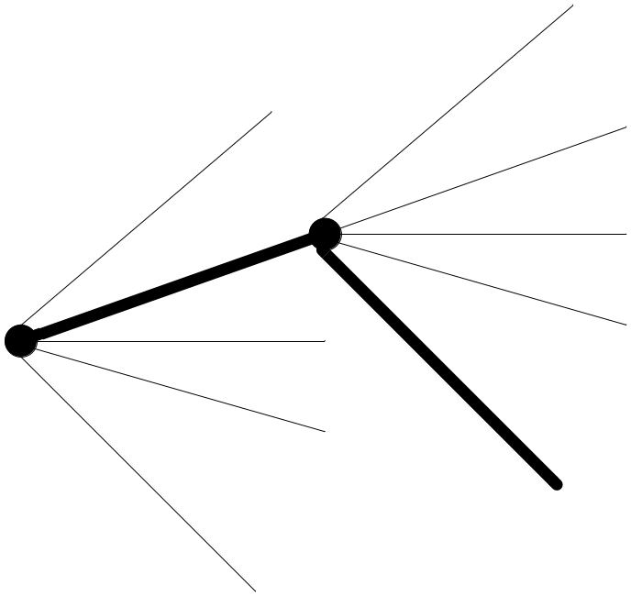
Greedy Technique
On each decision step the choice should be
Feasible
  has to satisfy the problem’s constraints
Locally optimal
  has to be the best local choice
Irrevocable
  once made, it can not be changed

Slide 5
Greedy Technique
Greedy Algorithm ( a [ 1 .. N ] )
{
solution = Ø
for i = 1 to n
x = select (a)
if feasible ( solution, x )
solution = solution U {x}
return solution
}

Slide 6
Greedy Technique
In each step, greedy technique suggests a greedy selection of the best alternative avaliable
  Feasible decision
  Locally optimal decision
  Hope to yield a globally optimal solution
Greedy technique does not give the optimal solution for all problems
There are problems for which a sequence of locally optimal choices does not yield an optimal solution
  EX: TSP, Graph coloring
  Produces approximate solution

Slide 7
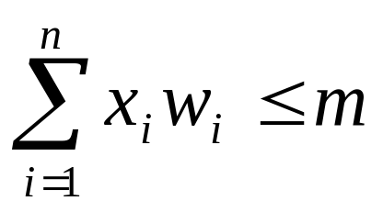
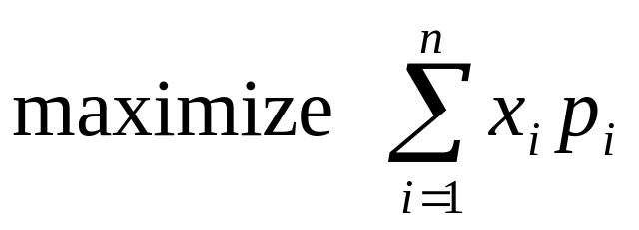
Fractional Knapsack Problem
Given :
  w_{i} : weight of object i
  m : capacity of knapsack
  p_{i} : profit of all of i is taken
Find:
  x_{i} : fraction of i taken
Feasibility:
Optimality:

Slide 8


Minimum Spanning Tree (MST)
Problem Instance:
  A weighted, connected, undirected graph G (V, E)
Definition:
  A spanning tree of a connected graph is its connected acyclic subgraph
  A minimum spanning tree of a weighted connected graph is its spanning tree of the smallest weight
    weight of a tree is defined as the sum of the weights on all its edges
Feasible Solution:
  A spanning tree G’ of G

Slide 9
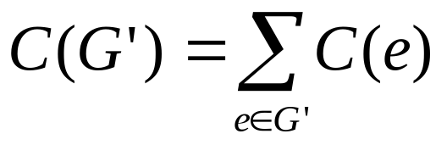
Minimum Spanning Tree
Objective function :
  Sum of all edge costs in G’
Optimum Solution :
  Minimum cost spanning tree

Slide 10
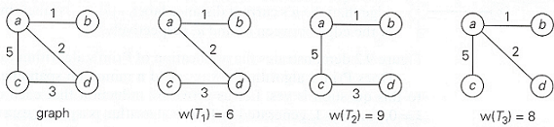
Minimum Spanning Tree
T₁ is the minimum spanning tree

Slide 11
Greedy Technique
Greedy Algorithm ( a [ 1 .. N ] )
{
solution = Ø
for i = 1 to n
x = select (a)
if feasible ( solution, x )
solution = solution U {x}
return solution
}

Slide 12
Prim’s Algorithm
Prim’s algorithm constructs a MST through a sequence of expanding subtrees
Greedy choice :
  Choose minimum cost edge add it to the subgraph

Slide 13
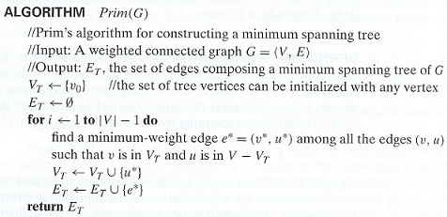
Prim’s Algorithm

Slide 14
Prim’s Algorithm
Approach :
  1. Each vertex j keeps near[j] Є T (current tree)
  where cost(j,near[j]) is minimum
  2. near[j] = 0 if j Є T
  = ∞ if there is no egde between j and T
  3. Use a heap to select minimum of all edges

Slide 15
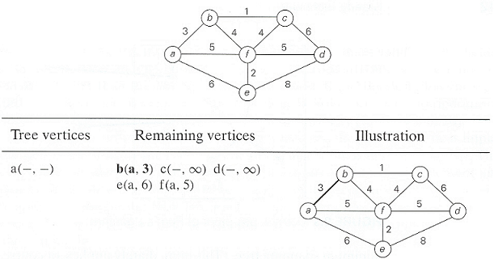
Prim’s Algorithm Example

Slide 16
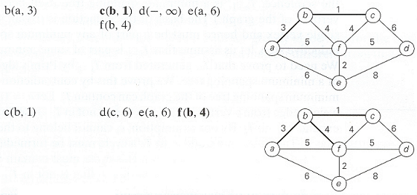
Prim’s Algorithm Example

Slide 17
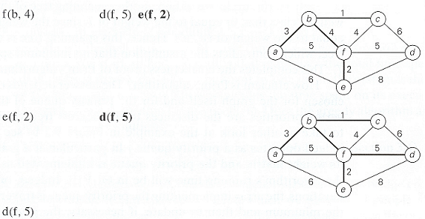
Prim’s Algorithm Example

Slide 18
Correctness proof of Prim’s Algorithm
Prim’s algorithm always yield a MST
We can prove it by induction
  T₀ is a part of any MST
    consists of a single vertex
  Assume that T_{i-1} is a part of MST
  We need to prove that T_{i}, generated by T_{i-1} by Prim’s algorithm is a part of a MST
  We prove it by contradiction
    Assume that no MST of the graph can contain T_{i}

Slide 19
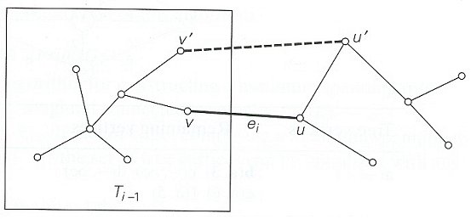
Let e_{i}=(u,v) be minimum weight edge from a vertex in T_{i-1} to a vertex not in T_{i-1} used by Prim’s algorithm to expant T_{i-1} to T_{i}
By our assumption, if we add e_{i} to T (MST), a cycle must be formed.
In addition to e_{i}, cycle must contain another edge (v’, u’).
If we delete the edge e_{k}, (v’, u’), we obtain another spanning tree
w_{ei} ≤ w_{ek} So weight of new spanning tree is less or equal to T. Since T is a MST, weight of new spanning tree can not be less. So, they are equal.
New spanning tree is a minimum spanning tree which contradicts the assumption that no minimum spanning tree contains T_{i}

Slide 20
Prim’s Algorithm
Initialize S with the start vertex, s, and V–S with the remaining vertices
for all v in V – S
if there is an edge (s, v)
Set cost[v] to w(s, v)
Set next[v] to s
else
Set cost[v] to ∞
Set next[v] to NULL
while V – S is not empty
for all u in V – S, find the smallest cost[u]
Remove u from V – S and add it to S
Insert the edge (u, next[u]) into the spanning tree.
for all v adjacent to u in V – S
if w(u, v) < cost[v]
Set cost[v] to w(u, v)
Set next[v] to u.

Slide 21
Prim’s Algorithm
Analysis :
How efficient is Prim’s algorithm ?
  It depends on the data structure chosen
  running time is Θ(|V|²) If
    graph is represented by its weight matrix
    unordered array is used
  running time of is O(|E|log|V|) If
    graph is represented by adjacency list
    priority queue such as a min-heap is used

Slide 22
Kruskal’s Algorithm
Another algorithm to construct MST
Expands a subgraph
  initially contains all the vertices but no edges
Generates a sequence of subgraphs
  always acyclic
  not necessarily connected
Resulting graph is connected and acyclic (i.e., tree)
Greedy choice :
Choose minimum cost edge
  Connecting two disconnected subgraphs
It always yields an optimal solution

Slide 23
Greedy Technique
Greedy Algorithm ( a [ 1 .. N ] )
{
solution = Ø
for i = 1 to n
x = select (a)
if feasible ( solution, x )
solution = solution U {x}
return solution
}

Slide 24
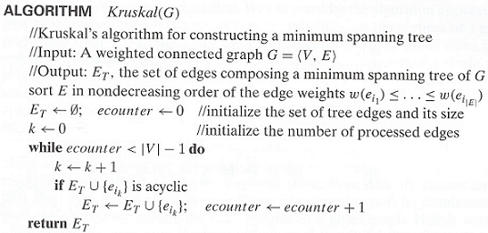
Kruskal’s Algorithm

Slide 25
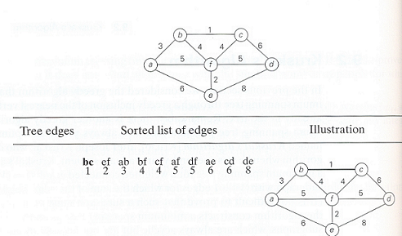
Kruskal’s Algorithm Example

Slide 26
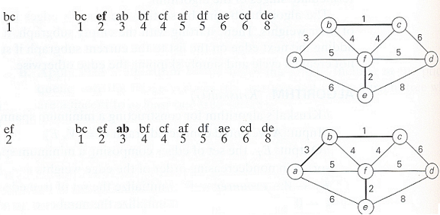
Kruskal’s Algorithm Example

Slide 27
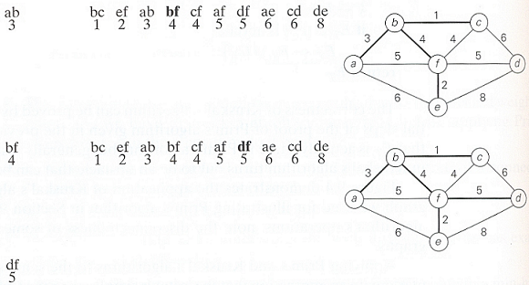
Kruskal’s Algorithm Example

Slide 28
Kruskal’s Algorithm
Algorithm requires at most n-1 unions and 2m finds
Analysis → O(|E| log|E|)

Slide 29
Single Source Shortest Paths
Definition:
  For a given vertex called source in a weighted connected graph, find shortest paths to all other vertices in the graph

Slide 30
Dijkstra’s Algorithm
Idea :
  Incrementally add nodes to an empty tree
  Each time add a node that has the smallest path length
Approach :
  1. S = { }
  2. Initialize dist [v] for all v
3. Insert v with min dist[v] in T
4. Update dist[w] for all w not in S

Slide 31
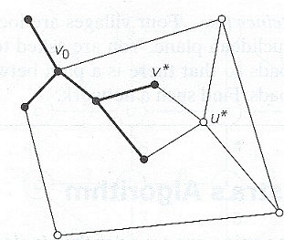
Dijkstra’s Algorithm
Idea of Dijkstra’s algorithm

Slide 32
Greedy Technique
Greedy Algorithm ( a [ 1 .. N ] )
{
solution = Ø
for i = 1 to n
x = select (a)
if feasible ( solution, x )
solution = solution U {x}
return solution
}

Slide 33
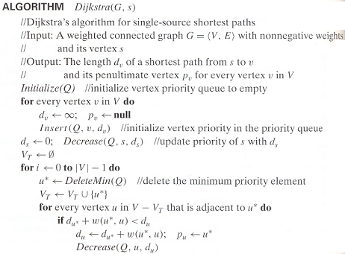

Slide 34
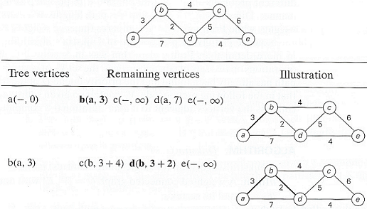
Dijkstra’s Algorithm Example

Slide 35
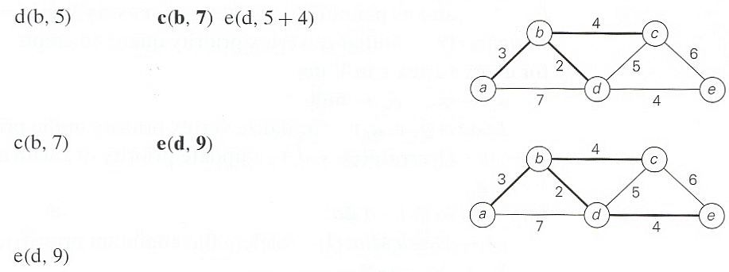
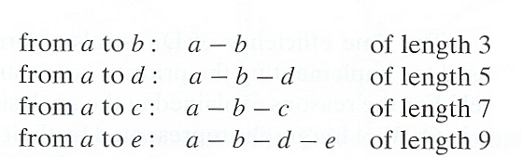
Dijkstra’s Algorithm Example

Slide 36
Dijkstra’s Algorithm
Analysis :
  Time efficiency depends on the data structure used for priority queue and for representing an input graph itself
  For graphs represented by their weight matrix and priority queue implemented as an unordered array, efficiency is in Ө(|V|²)
  For graphs represented by their adjacency list and priority queue implemented as a min-heap efficiency is in O(|E|log|V|)
  A better upper bound for both Prim and Dijkstra’s algorithm can be achieved, if Fibonacci heap is used

Slide 37
Encoding Text
Suppose we have to encode a text that comprises characters from some n-character alphabet by assigning to each of the text’s characters some sequence of bits called codeword
We can use a fixed-encoding that assigns to each character
  Good if each character has same frequency
  What if some characters are more frequent than others

Slide 38
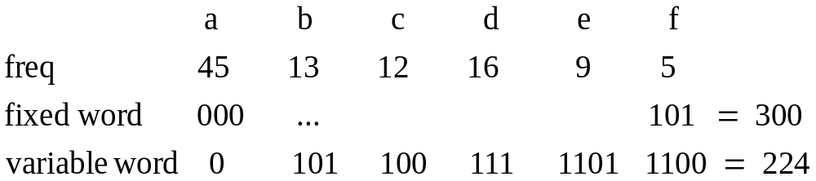
Encoding Text
EX: The number of bits in the encoding of 100 characters long text

Slide 39
Prefix Codes
A codeword is not prefix of another codeword
  Otherwise decoding is not easy and may not be possible
Encoding
  Change each character with its codeword
Decoding
  Start with the first bit
  Find the codeword
    A unique codeword can be found – prefix code
  Continue with the bits following the codeword
Codewords can be represented in a tree

Slide 40
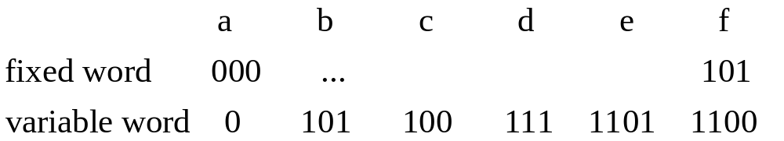
Prefix Codes
EX: Trees for the following codewords…

Slide 41
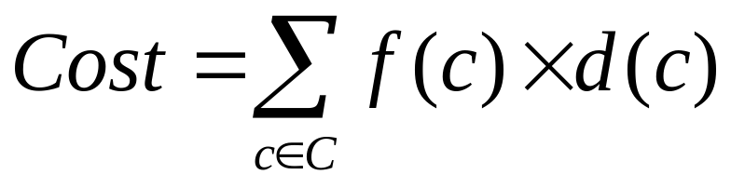
Huffman Codes
Given: The characters and their frequencies
Find: The coding tree
Cost : Minimize the cost
  f(c) : frequency of c
  d(c) : depth of c

Slide 42
Huffman Codes
What is the greedy strategy?

Slide 43
Huffman Codes
Approach :
  1. Q = forest of one-node trees
  // initialize n one-node trees;
  // label the nodes with the characters
  // label the trees with the frequencies of the chars
  2. for i=1 to n-1
  3. x = select the least freq tree in Q & delete
  4. y = select the least freq tree in Q & delete
  5. z = new tree
  6. (z→left = x and z→right = y) or (z→right= x and z→left= y )
  7. f(z) = f(x) + f(y)
  8. Insert z into Q

Slide 44
Greedy Technique
Greedy Algorithm ( a [ 1 .. N ] )
{
solution = Ø
for i = 1 to n
x = select (a)
is feasible ( solution, x )
solution = solution U {x}
return solution
}

Slide 45


Huffman Codes Example
Consider five characters {A,B,C,D,-} with following occurrence probabilities
The Huffman tree construction for this input is as follows

Slide 46
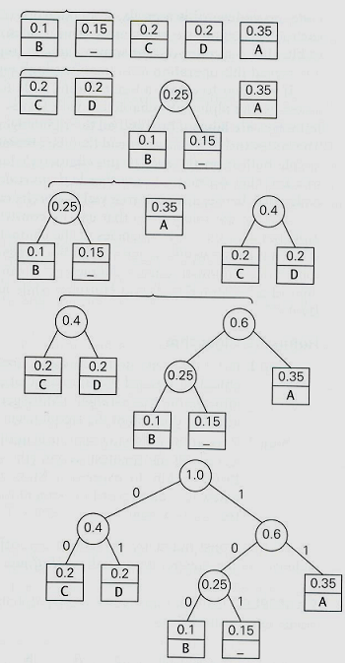

Slide 47
Huffman Codes
Optimality Proof :
  Tree should be full
  Two least frequent chars x and y must be two deepest nodes
  Induction argument
    After merge operation → new character set
      Characters in roots with new frequencies

Slide 48
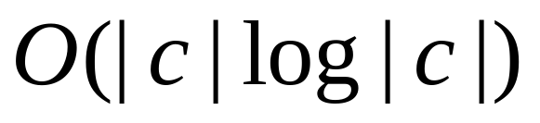
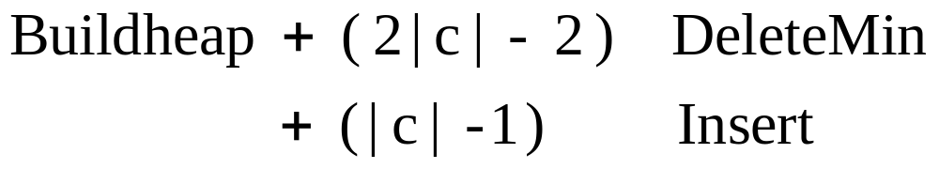
Huffman Codes
Analysis :
  Use priority queues for forest

